Slide 1
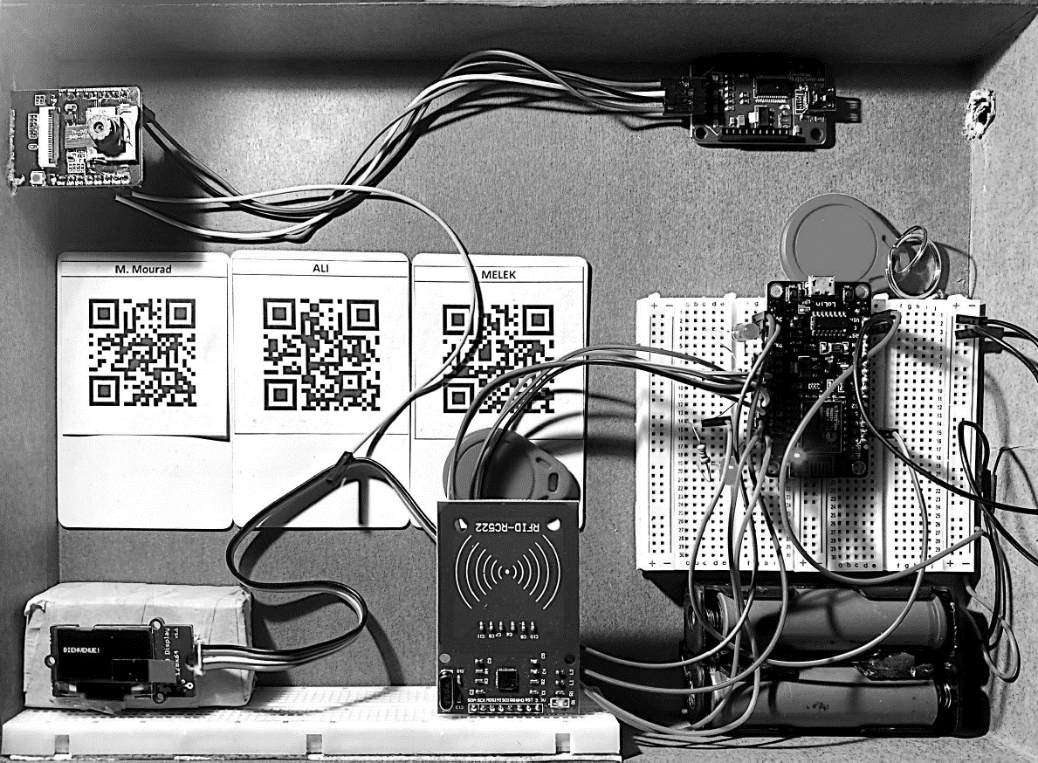


End-of-Year Project
Department of Electronics and Communications
Smart Locker System
Elaborated by :
Supervisor :
Maghrebi Mohamed Ali
Ben Romdhane Melek
Mr. Fakhfakh Mourad
2nd year in Electronics and Communications Engineering
Academic year : 2022 - 2023
Notes:
Good morning; we are maghrebi mohamed ali and ben romdhane melek ;
Wen are glad to present to you our end of year project named smart locker system supervised by Mr Mourad fakhfakh

Slide 2
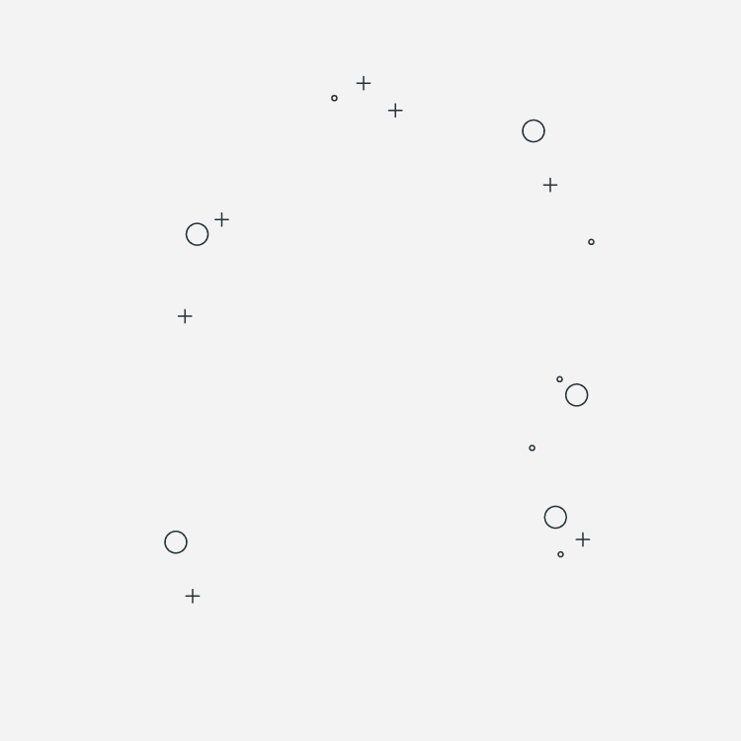

01. Introduction
04. Software design
02. Proposed solution
05. Conclusion
03. Hardware design
06. Perspectives
Plan
Notes:
Our plan consists of six parts first ,,,,,,,,,, second ,,,,,,,,,,,, third ,,,,,,,,,,,, forth ,,,,,,,,,,,,,, we conclude by conclusion and perspective

Slide 3

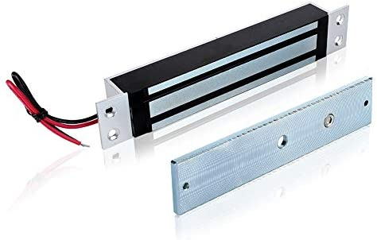
Review of the EXISTING infrastructure
Traditional locking mechanisms refer to physical locks that have been used for centuries to secure personal valuables.
Padlocks
Electronic locking systems are a type of locking mechanism that use electronic components to control access to a locked object.
Electric magnetic lock
They provided a basic level of protection.
Notes:
Our project present a solution for an existing infrastructure which are ,,,,,,,,,,,,,,,,,,,,,

Slide 4


Problematic situation
How can the transition from traditional electric locks and padlocks to an intelligent solution based on SMART technologies enhance the efficiency and security of locking systems?
What steps are required to implement this transition, and what is the impact on operational efficiency and associated costs?
Notes:
So ,,,,,,,,,,,,,,, and

Slide 5

01
Introduction

Slide 6

Overview of Smart electronic locking systems
Smart Electronic locking systems are a type of locking mechanism that use electronic and biometric components to control access to a locked object
They are designed to provide enhanced security, access control compared to traditional locking mechanisms.
1

Slide 7


02
Proposed Solution

Slide 8



Solution
Short teComponents
The Smart Locker System solution is comprised of three main components: facial recognition, QR code, and RFID tag.
Long Goals
By using a combination of facial recognition, QR code, and RFID tag technologies, the proposed Smart Locker System solution provides a range of options for users to access lockers quickly and easily
2

Slide 9



Use cases
The Smart Locker System solution offers a wide range of use cases and can be applied in various settings where secure and convenient storage is needed
01
Public places
02
Work places
03
Banks
3

Slide 10

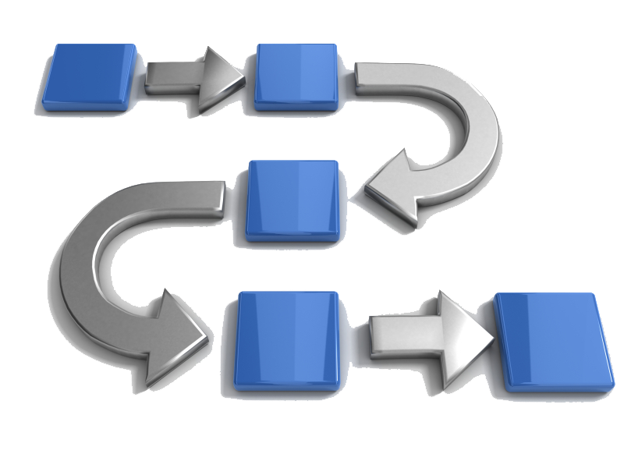
Solution modeling
The use case diagram
The state machine diagram
It provides a detailed view of the different states of the system and the transitions between them, it is used to show how the system behaves
The sequence diagram
4

Slide 11
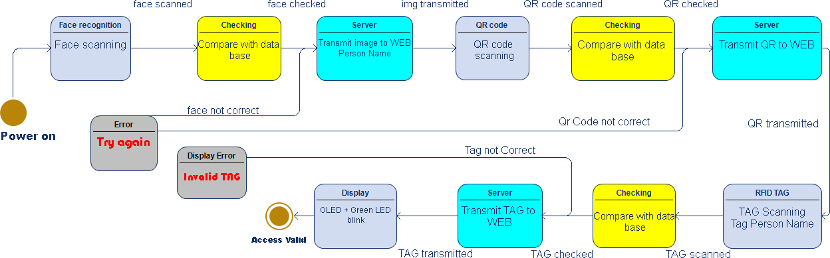
State machine diagram
We will give more attention to the State machine diagram
5

Slide 12
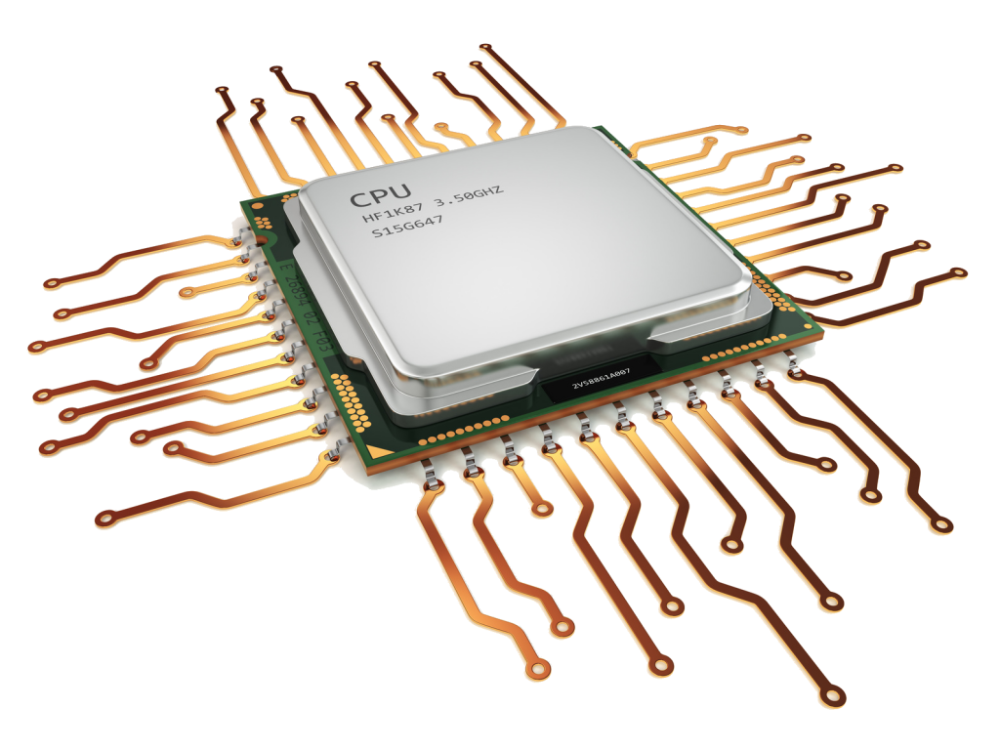
03
Hardware Design and Implementation
Notes:
We move now to the section of hardware

Slide 13
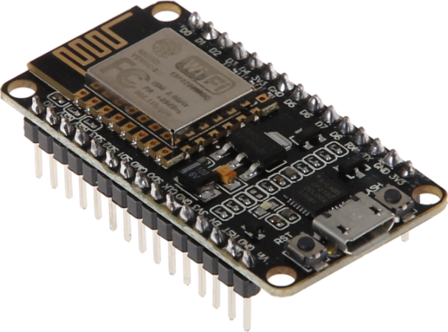
Hardware components
The Smart Locker System is comprised of several hardware components, each playing a crucial role in the system's functioning. In this section, we will discuss each component in detail, including its physical and technical specifications.
The next table presents a comparison between the NodeMCU and the different boards:
Board | Wifi capability | Digital I/O Pins | Analog I/O Pins | Frequency | Other characteristics
NodeMcu ESP 8266 | Built in Module Wifi | 11 | 1 | 80MHZ | Suitable for low-power applications
STM32F407VGT6 | Wifi module required | 82 | 16 | 1.4GHZ to 1.5GHZ | Suitable for embedded systems and microcontroller-based projects
Raspberry-Pi 3 | Built in Module Wifi | 17 | No one | 72 MHZ to 120 MHZ | Full-fledged computer with rich features and capabilities
Arduino uno | Wifi module required | 14 | 6 | 16 MHZ to 48 MHZ | Popular platform for prototyping and DIY projects
NodeMCU ESP-8266
6
Notes:
We start with NodeMcu board ,,, this frequency is ranged between ,,,,,, and ,,,,,,,,,,,,,,,,, for STM32 module wi need an external wifi module

Slide 14
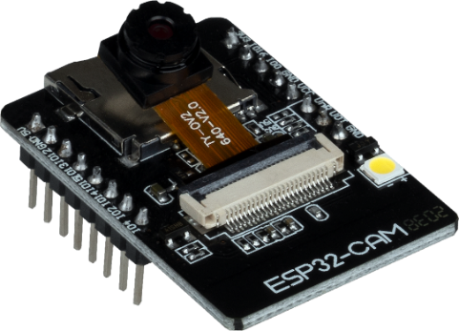
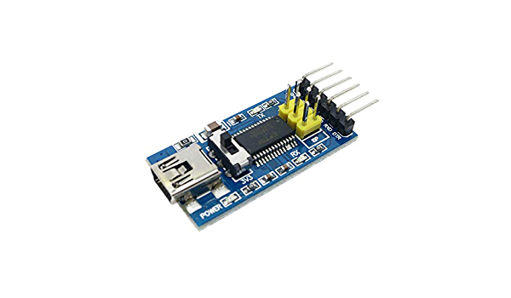
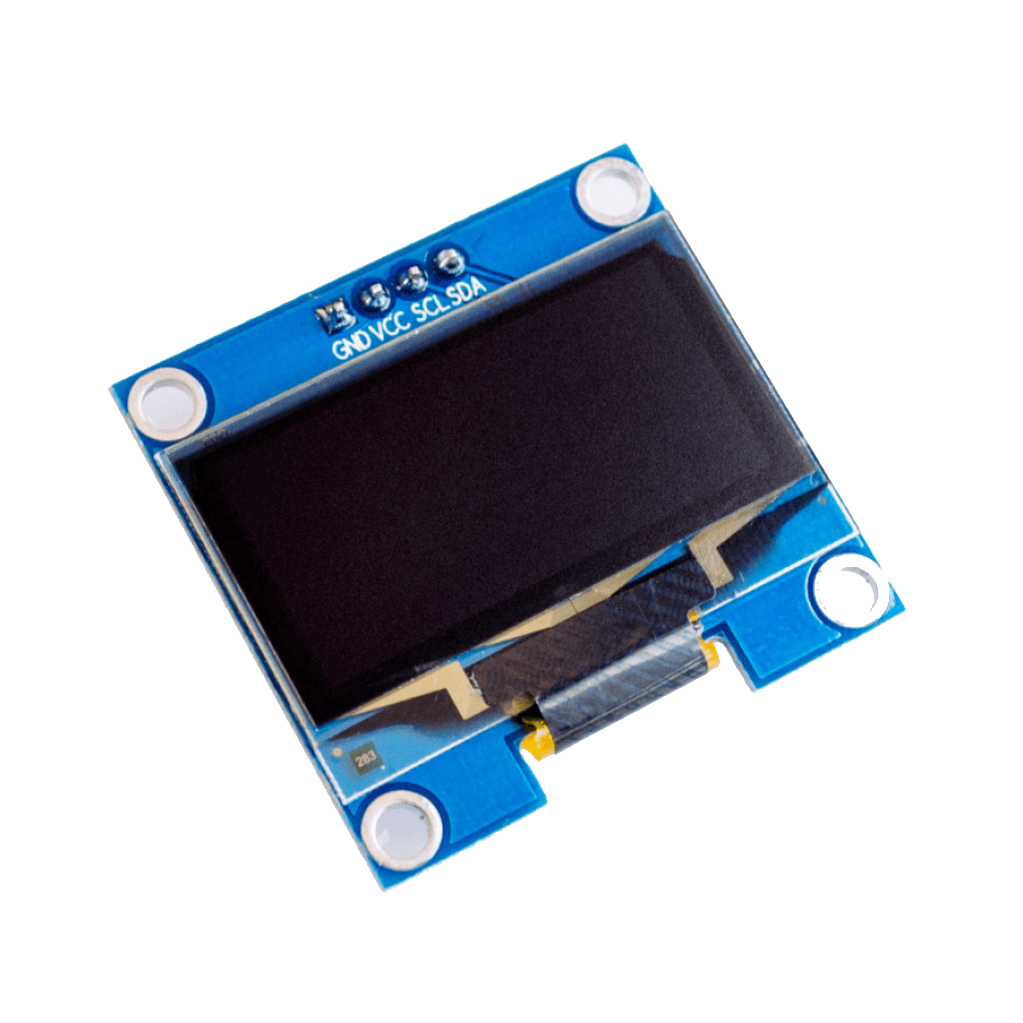
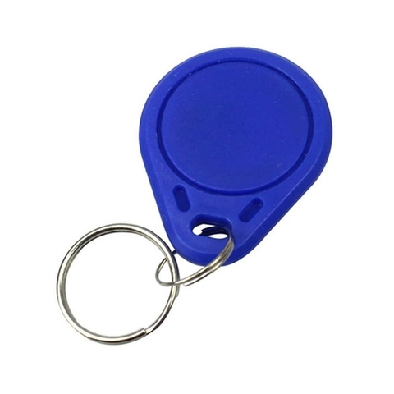
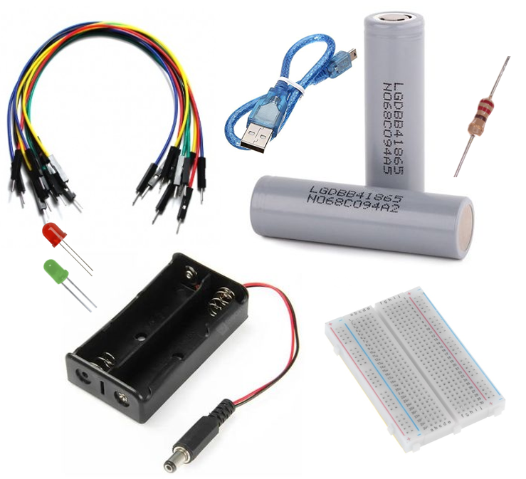
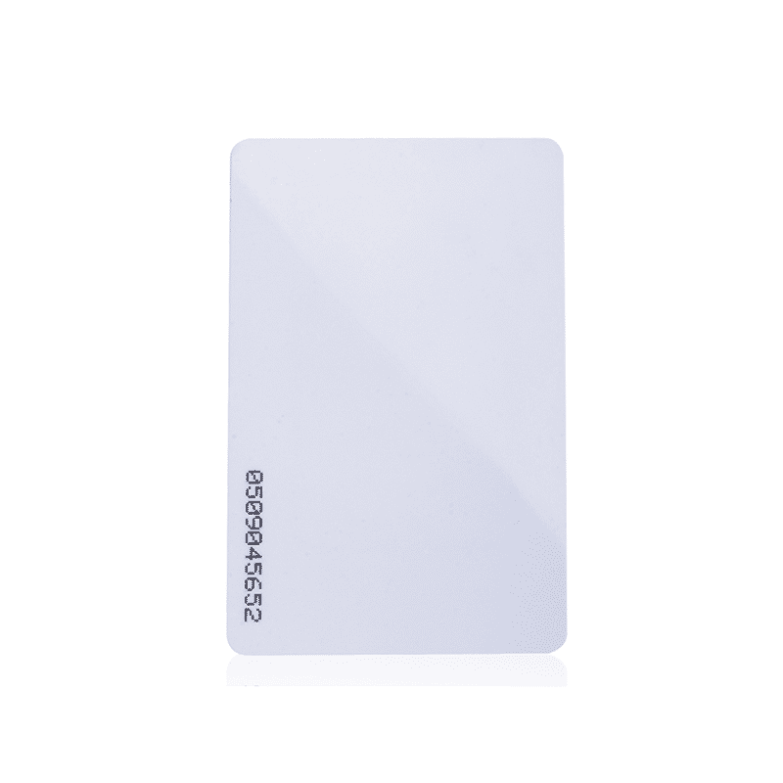
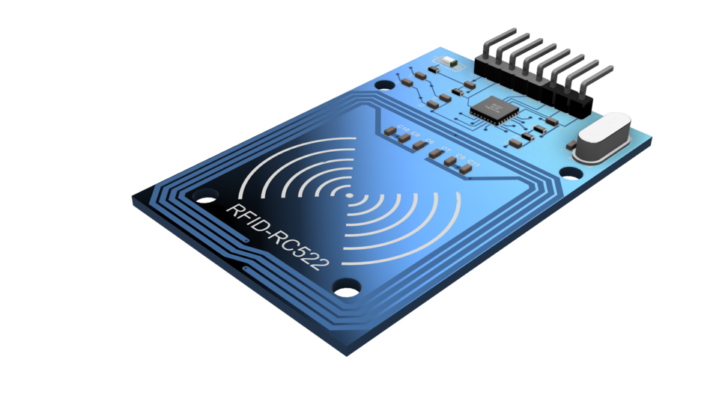
ESP32-CAM module
TTL to USB module
OLED display module
Kit RFID RC522 Reader
Other components
7
Notes:
Also we have an ESPCam module for face recognition and Qr detection, the ttl to usb module to upload script in the ESP cam ; the Oled to diplay information ; moreover the Kit RFID for the identifation and finally we have other component like batteries breadboars wires lesd with resistors

Slide 15
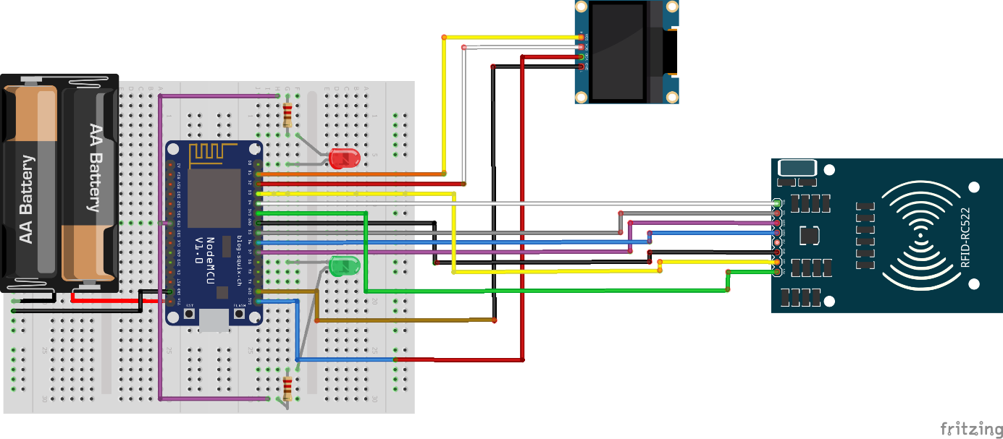
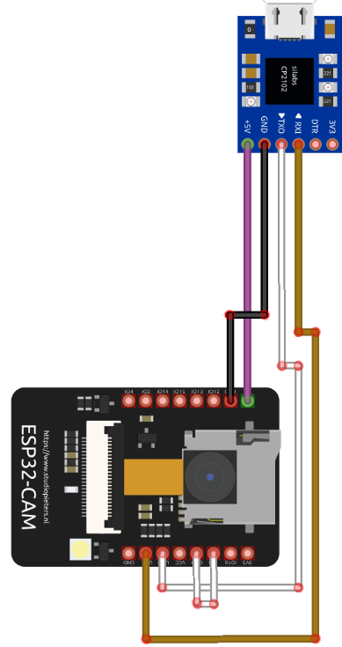
Hardware integration, Design and implementation
The system utilizes the UART and I2C interfaces for communication. These interfaces enable efficient data exchange between the NodeMCU8266 board and the different components.
To create these connections, we used a software tool called Fritzing
8
Notes:
The module esp is cabled with TTL to usb ; the powe on of board which are connected with OLED via SCL, SDA ,GND and Vcc ; thes ome choice for RC522 ; also we need two leds with resistors to shows the final informations of systems
SCL : Serial Clock SDA : Serial Data

Slide 16

04
Software Design

Slide 17




Technologies
The Smart Locker System is made up of several software components
We used the following tools to accomplish the project
Arduino IDE
VS code
XAMPP
Used to program the NODEMCU ESP8266 microcontroller, which controls the system's hardware components
This is an integrated development environment (IDE) used to write the software code that runs on the Smart Locker System
This is a cross-platform web server solution used to manage the Smart Locker System. It includes the Apache web server, MySQL database, and PHP interpreter
9

Slide 18


Technologies
The Smart Locker System is made up of several software codes and libraries
Arduino IDE
Python codes
HTML codes
Codes:
Esp.ino: sets up a web server that allows users to control the ESP32 camera module.
Nodemcu.ino: An Arduino script for an RFID tag, OLED display and Led command
Codes:
QRgen.py : generate QR codes from a given string and save them as PNG files
esp.py : sets up a TCP/IP socket server between Mysql and ESP8266
Face.py: The program captures an image, detects faces, and compares them with MySQL data base.
QR.py: read QR codes from a live video stream and mark attendance in a database.
Codes:
Information.html:displays a table of client information with five columns
Sys.html: provides a table of hardware and software requirements
Home.html: describes the main content of work by linking to external resources
10

Slide 19

Technologies
The Smart Locker System is made up of several software codes and libraries
PHP codes
Libraries
Codes:
Index.php: uses HTML, CSS, JavaScript, and PHP to display attendance records in a table format and includes a live video feed from an ESP-32 CAM. .
MFRC522 library : to interface with the RFID reader
Adafruit SSD1306 library: to display the tag ID on an OLED display
RFID Scan & Display
OpenCV, face_recognition, and MySQL: code Face .py
Face Recognition
OpenCV, Pyzbar and MySQL: code QR .py
QR Scan
11

Slide 20

Software components relations
To facilitate the connection between the software architecture, a schematic can be used as a visual representation of the system components and their relations
Arduino IDE
VS code
Browser
Port 80
Port 80
Port 80
ESP.ino
OLED.ino
RFID.ino
Autorun.py
Home.html
Style.css
Index.css
IP CAM
TEST
TEST
02
03
FLASK
01
01
QR.py
ESP.py
Face.py
Final_Script.ino
Port 17
Port 17
Port 17
Port 5002
ESP Cam
Informations Page
ESP Cam
RFID Scanner
QR gen
Port 3306
Port 3306
Port 3306
Data base
Data base
Data base
XAMPP
Port 80 +3306
Apache
MySQL
12
Notes:
Which create

Slide 21
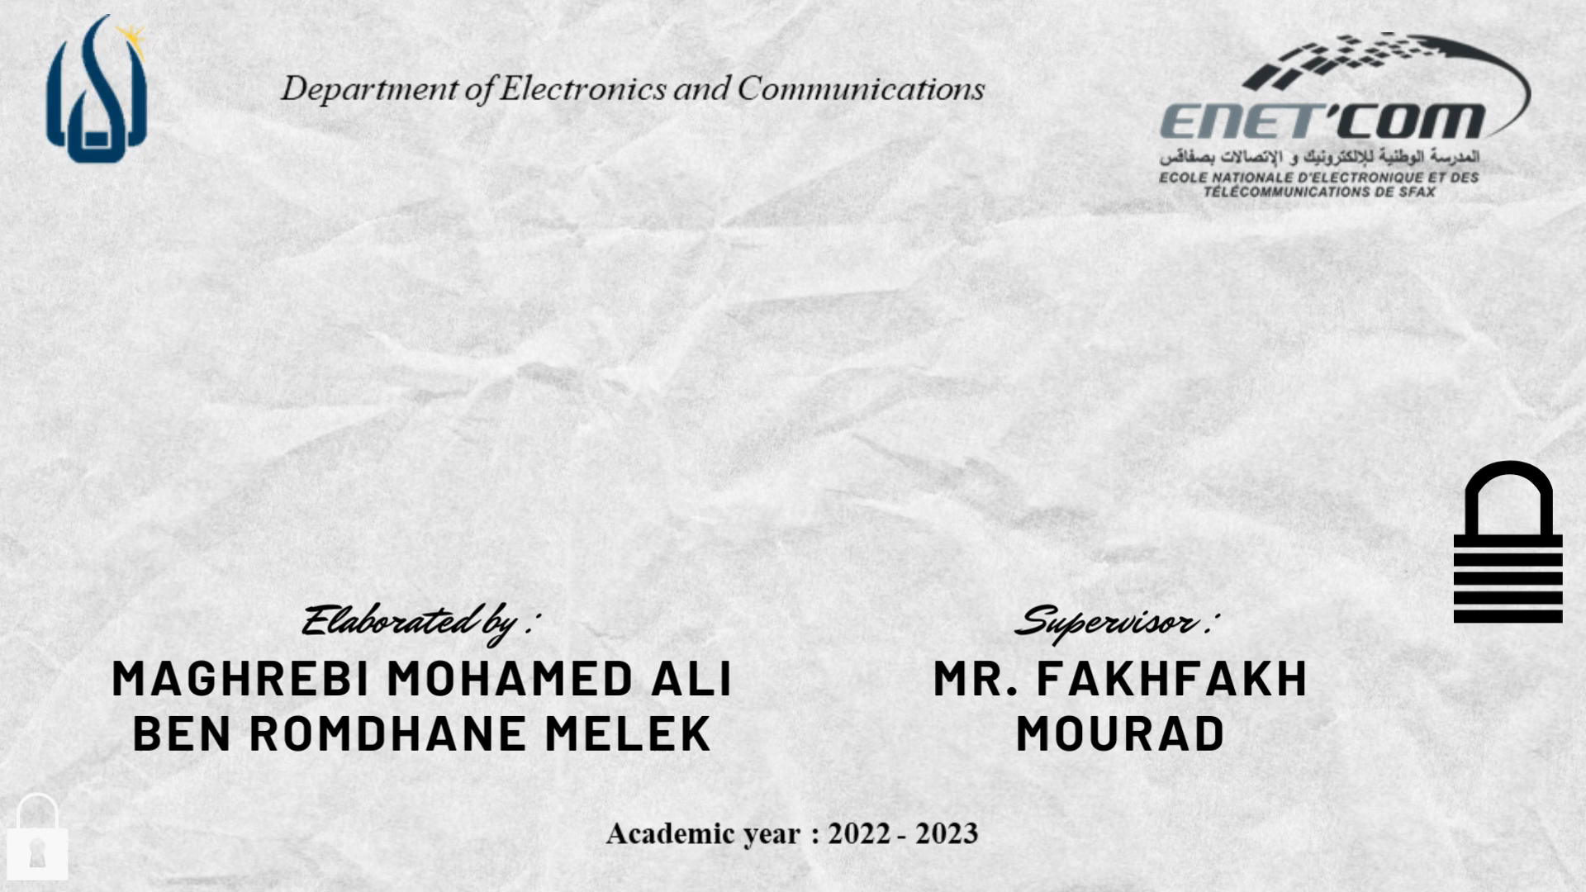
13

Slide 22

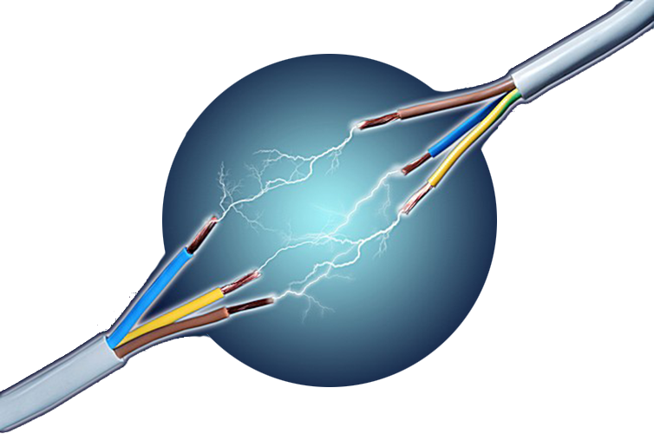
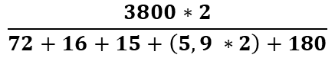
Energy Consumption Analysis
DC power supply | 3800 mA/H
RFID Reader | 16 mA
Oled Display | 15 mA
LED indicators with 220 Ohm resistors | 5,9 mA
ESP-32 Cam | 180 mA
ESP8266 Board | 72 mA
Duration of power supply =
$$\frac{3800∗2}{72+16+15+\left(5,9 ∗2\right)+180}$$
26 Hour and 18 Minute
1 DAY ; 2 Hours ; 18 Minute
14

Slide 23

Economic study
The total cost of the project, based on the components used, is 198.500 TND
This cost includes the following hardware components and their respective prices:
ESP8266 Nodemcu - 30.000 TND
ESP-32 cam - 60.000 TND
OLED display - 23.500 TND
RFID RC-522 and tags - 25.000 TND
TTL to USB module - 10.000 TND
Two power energy 12 V with support - 35.000 TND
Two breadboards - 10.000 TND
Other components like wires, LED, and resistors - 5.000 TND
15

Slide 24


Project Timeline
The project was realized over a period of two months:
One month dedicated to documentation
Another month allocated for the actual work
16

Slide 25
The implementation of the system has been discussed in details, including the hardware components, the software tools with different programming languages and libraries
The Smart Locker System presented is an innovative solution that offers high-security storage facilities with the latest technologies, such as AI and IoT
Conclusion
17

Slide 26
The Smart Locker System offers a promising perspective for the future. By integrating with existing infrastructure and incorporating a door actuator solution
We can incorporate a feature that includes an alarm or an SMS alert that will be triggered when the number of false entrance conditions exceeds three consecutive repetitions
Perspectives
We have established three conditions to enhance the system and explore additional technologies However, the client has the freedom to choose the options that best suit their own system preferences
18

Slide 27
